Slide 1
Chapter 1_3
THE MECHANICS OF THE BODY
Dr rafid albadr |

Slide 2
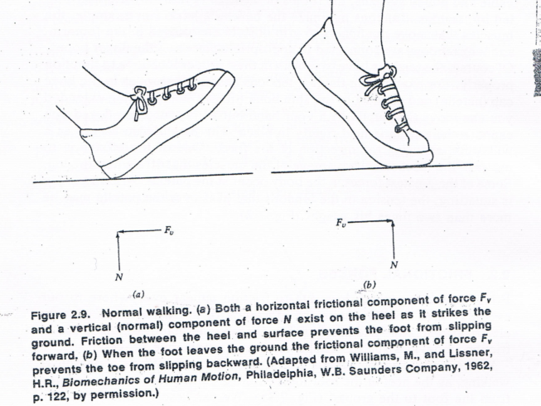
Friction
Defin
When two surfaces are in contact, their irregularities intermesh, and as a result there is a resistance to the sliding or moving of one surface on the other.
frictional force depends
Force
Nature of the surfaces
frictional force does not depend on the size of the contact area

Slide 3

The frictional force F_{f} is given by
$$F_{f}=μF_{n}$$
µ is the coefficient of fraction between the two surface.

Slide 4
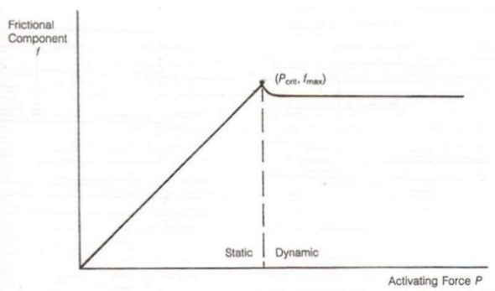
TABLE Coefficients of Friction, Static (μs) and Kinetic (μk)
Surfaces | μ_{s} | μ_{k}
Leather on oak | 0.6 | 0.5
Rubber on dry concrete | 0.9 | 0.7
Steel on ice | 0.02 | 0.01
Dry bone on bone |  | 0.3
Bone on joint, lubricated | 0.01 | 0.003
Human joints (lubricated with synovial fluid) | 0.005 | 0.005

Slide 5
The coefficient of fraction
The coefficient of fraction in bone joints is usually much lower than the engineering type material.
Synovial fluid in the joint is involved in the lubrication.
An example of the importance of friction in dentistry lies in the concept of roughening the surface of a dental implant to reduce motion between the implant and adjacent tissue. It is perceived that a rough surface and resultant less motion will provide for better osseointegration. Friction is also important in sliding mechanics used in the orthodontic movement of teeth. The saliva we add when we chew food acts as a lubricant. If you swallow a piece of dry toast you become painfully aware of this lack of lubricant.

Slide 6
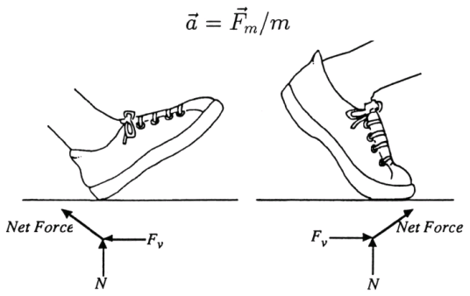

Example: 1
Acceleration a can be caused by leg muscle force F
  Deceleration can be caused by friction, muscle force or external forces
For a walker of $F_{n}$ ≈ W ≈ 800 N (m=82kg):
Friction force:
$F_{f}=μW=0.8 ×800$
F_{f} ≈ 640 N
$F=a m$
Deceleration: $a=\frac{F_{f}}{m} ≈7.8 m/{s^{2}}$

Slide 7

Example 2:
Standing at an Incline
The force F_{n} normal to the inclined surface is
$$F_{n}=W cosθ$$
The static frictional force F_{f} is
$$F_{f}=μF_{n}=µ×W cosθ=0.6× W cosθ$$
The force parallel to the surface F_{p}, which tends to cause the sliding, is
$$F_{p}=W sinθ$$
The person will slide when the force Fp is greater than the frictional force Ff ; that is, Fp > Ff
At the onset of sliding, these two forces are just equal; therefore,
$F_{f}=F_{p}$ : $0.6 W cosθ=W sinθ$
$$\frac{sinθ}{cosθ}=tanθ=0.6$$
Therefore θ = 31◦.

Slide 8

Dynamic forces:
Newton's second law:
$$A=\frac{F}{m}$$
$$F=a m (a=∆v/∆t)$$
$$F=m\frac{∆v}{∆t}$$

Slide 9
Accelerations can produce a number of effects such as
1. An apparent increase or decrease in body weight
2. Change in internal hydrostatic pressure
3. Distortion of the elastic tissues of the body
4. The tendency of solids with different densities suspended in a liquid separate

